Slide 1


Deep learning project
Generative
adversarial
network
Presented by:
BOURZIK Asmaa
ESSOULLAMI Mostapha
OUAHID Omar

Slide 2

01
02
03
04
05
06
Definition
Architecture of GANs
Steps
Mnist handwritten digits
Code
Conclusion
Contents

Slide 3

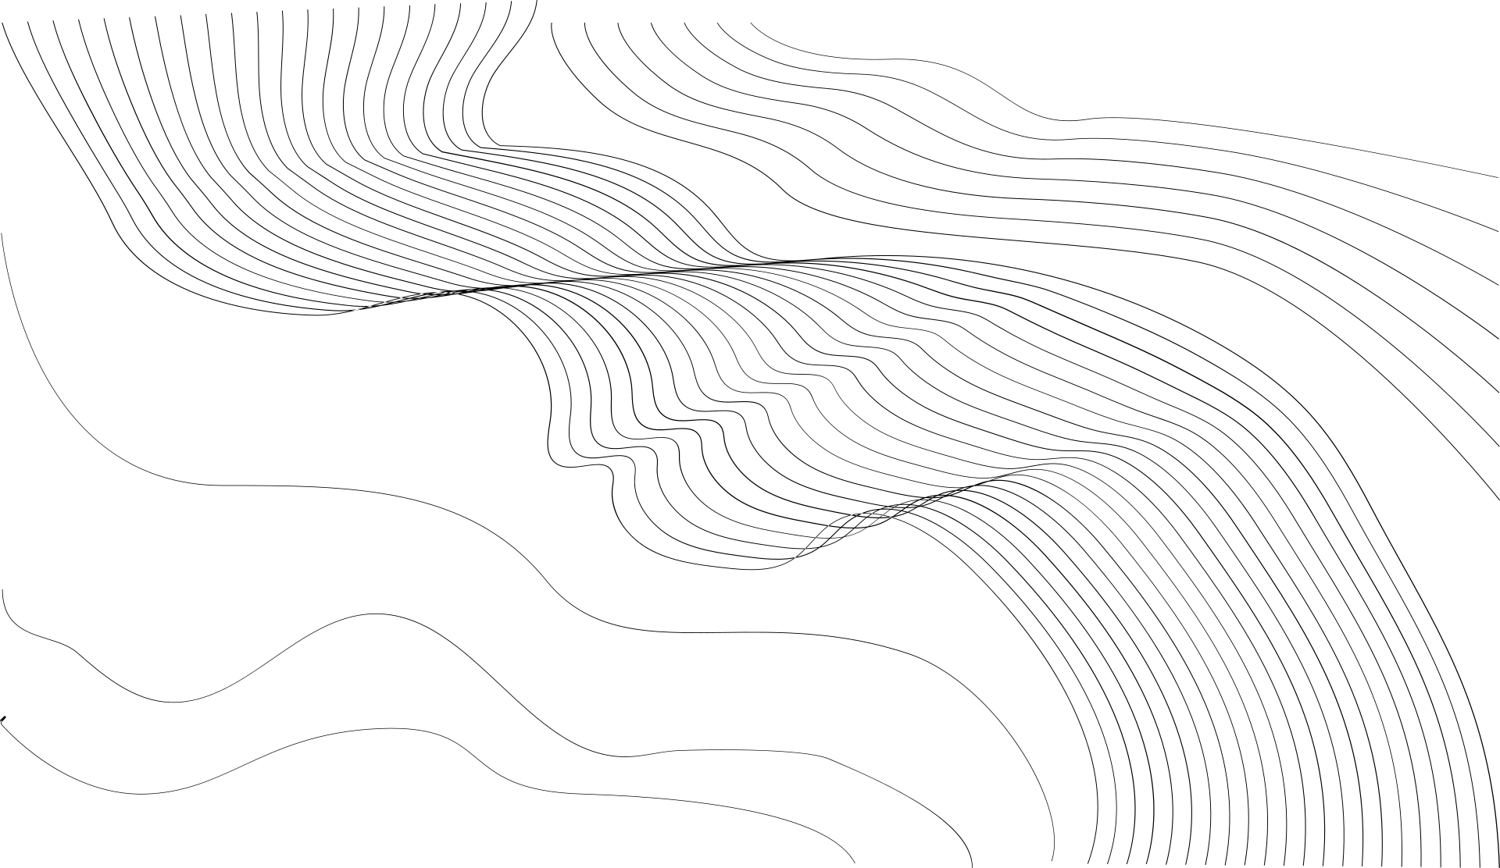
03
Definition:
GANs are generative models; they create new data instances that resemble your training data.
It works by paring a generator and a descriminator.

Slide 4
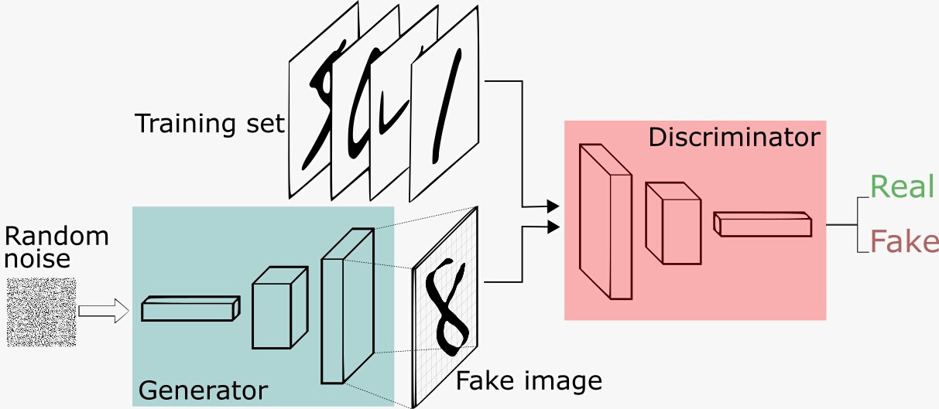
Architecture:
04

Slide 5
1
Define and Train the Discriminator Model
2
Define and Use the Generator Model
THE
STEPS:
3
Train the Generator Model
4
Evaluate GAN Model Performance
07

Slide 6

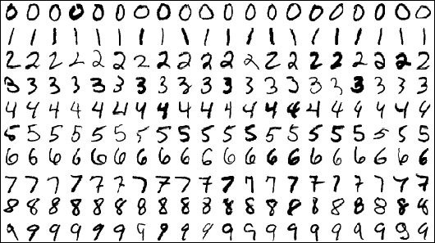
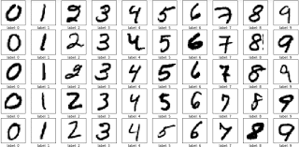

05
Mnist handwritten digits:

Slide 7


06
It is a dataset of 70,000 small square 28×28 pixel grayscale images of handwritten single digits between 0 and 9
The task is to classify a given image of a handwritten digit into one of 10 classes representing integer values from 0 to 9

Slide 8


08
CODE

Slide 9
Conclusion:
09
To summarize, in this presentation we discussed the generative adversarial network, we showed that GANs simultaneously train two neural networks, one used for data generation and the other for data discrimination.

